Slide 1
Stargaze: A LEO Constellation Emulator for Security Experimentation
Patrick Tser Jern Kon, Diogo Barradas, Ang Chen
Notes:
Hello everyone, I’m Patrick, a 2nd year phd student from Rice University, and this is a joint work with Diogo from U Waterloo and Ang from Rice.
Today I will be presenting, Read the title: A “low earth orbit” constellation emulator…
This paper is a very preliminary work, that is in progress, the aim of this work is to galvanize further research in this space. We hope to get feedback from the community on how to progress with this system.
Questions for Ang and Diogo:
Is it ok to talk about the drawbacks of our system during the presentation? Since we are still a work in progress

Slide 2
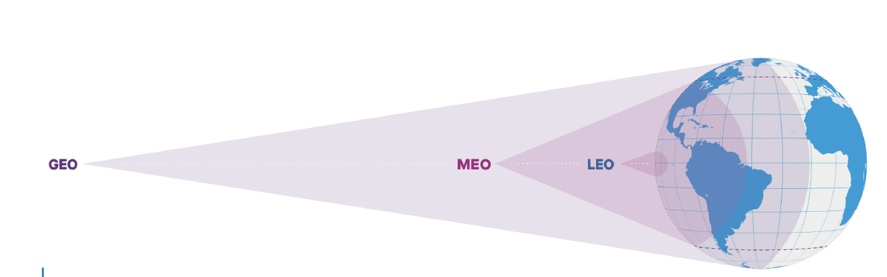
How do Low-earth orbit (LEO) constellations work?
Notes:
Here, we give a very quick overview of what a LEO actually is. More details later. This is a depiction of what a LEO satellite is, in comparison to a MEO and GEO. A LEO satellite as you see is much closer to the earth, but it has a smaller cone of coverage, which means it can only reach a smaller area on the ground. This is a motivation for using LEO constellations as you can get much bigger (and possible global) coverage than just using a single satellite.
Say LEOs have higher speed but intermittency. GEOs have constant.
Lower latency* with global coverage
Mention “reconfigurable links”
Q:
Can GS accept connections to multiple SATs?
What is the orbital velocity of LEOs? Is it much faster? What is the period of LEOs? Is polar LEO longer or shorter orbital period?
orbital velocity is more than 27,000 km/hr, and satellites complete an orbit around the Earth in ∼100 minutes [6]. As satellites travel fast across GSes, GS-satellite links can only be maintained for a few minutes, after which they require a handoff. ISLs also continuously change in length
What is the distance of LEOs and MEOs from earth’s surface?

Slide 3
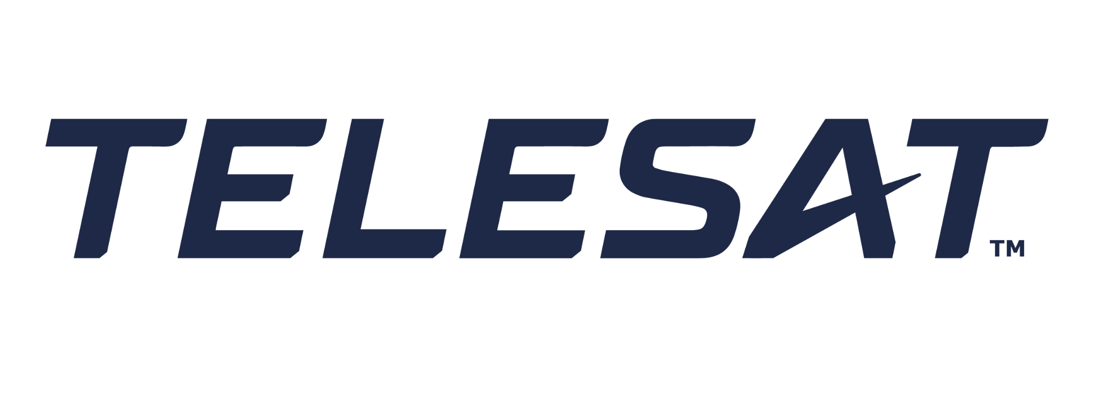
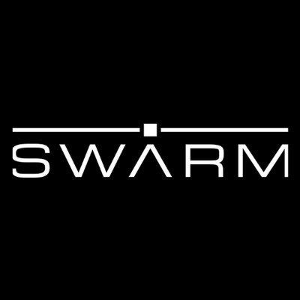
LEO constellations are on the rise!
Technological advances
New business models and better funding
High bandwidth demand from underserved regions
Economies of scale
Launched: 2923
Planned: ~42000
~$700K USD / SAT
Notes:
https://www.mckinsey.com/industries/aerospace-and-defense/our-insights/large-leo-satellite-constellations-will-it-be-different-this-time
We have a variety of constellations being proposed/deployed.
Some of the older ones, iridium from motorolla. Recently, you have Amazon Kuiper and especially Starlink in recent news.
By the numbers, give stats
https://www.newspace.im/
Technical advances:
spectrum usage (higher frequencies enable higher data rates. While improved ground-station design and adaptive coding counter the increased susceptibility to attenuation)
ISLs
New business models:
Venture capital has recently been bullish about space projects, investing more than $4 billion in the past two years alone.
Some companies have enough cash available to build and deploy a constellation outright. Apple considering w/ USD$107B.
Higher bandwidth….:
Today’s customers demand Global constant/unlimited connectivity: this is enabled by competitive pricing nowadays. And includes underpopulated regions and avenues such as in-flight internet, long-distance mobile backhaul, maritime internet, remote oil and gas extraction, and certain military applications.
Economies of scale
private industry involvement,
reduction in launch costs,
commoditized hardware
Here we see a few examples of such constellations. Such as the traditional telesat, iridium, and now kuiper, and a company you’ve probably seen on the news, starlink

Slide 4
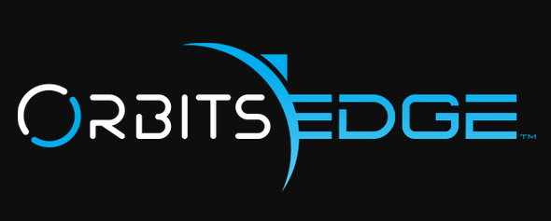
Imagination is the limit
High-speed networking
Underserved or unpopulated regions
Battlefield regions
Potentially well connected regions
Edge compute
Image and video processing
Weather observation
ML
General services
Federated learning on SAT data
Wartime services
Remote sensing
Notes:
There is a growing demand for various space services in recent years, the sky is indeed the limit.
Underserved regions: this includes serving rural terrestrial areas, maritime and aviation related connectivity
Battlefield regions: ukraine
Well connected regions: there are reports that starlink has faster speeds than terrestrial internet in certain european countries, and existing work that give caveats to this (e.g., certain distance before speeds are faster)
Further, we have edge compute services, that focus on in-orbit processing of information, with for example, radiation hardened commodity servers in the case of orbitsedge.
Finally, we have general services, that range from federated learning on SAT data, and so on.

Slide 5
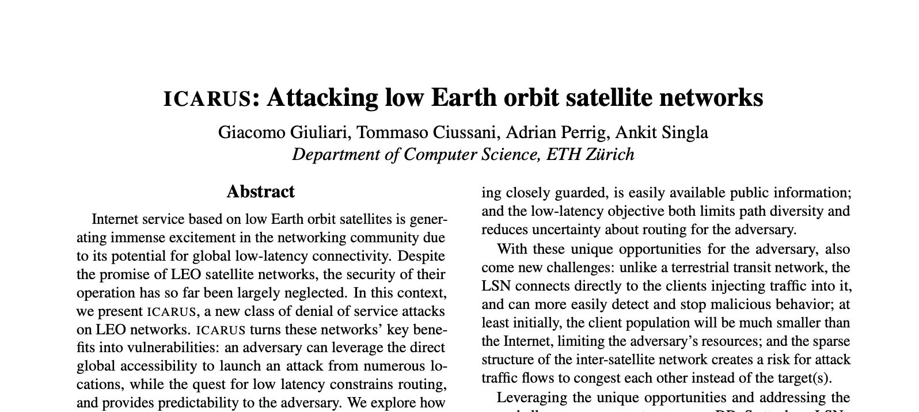
Unique Security Landscape of LEO constellations
Physical inaccessibility that complicates human intervention
Use of COTS equipment and growing private industry involvement
Mobility and lack of physical perimeters
Sheer volume of SATS
DoS and spoofing
Remote hijacking
Physical attacks
Notes:
Despite the growing importance of nascent LEO satellite constellations, research has yet to catch up in terms of the identification, evaluation, and mitigation of their security threats. Indeed, With compute, networking, storage, and sensory systems equipped to each satellite, current LEO constellations, while prone to a similar range of threats like those affecting terrestrial cyber-physical systems or even other types of satellites (e.g., GEO satellites), these threats' details are markedly distinct. Such differences stem from a few reasons, including, LEO constellations'....
Mention volume: large number of satellites, incl. Those proposed by the military: could make it hard to determine which satellites have been compromised by adversaries.
Many more reasons. Details in paper.
Guidelines:
Example: currently, “the defense industrial base is required to report all cyber incidents that have impacted or could impact national security under the Department of Defense-Defense Industrial Base Cybersecurity Activities Regulation.” However, space systems are not included in this industrial base.
Refer to “Falco, G. (2018). The Vacuum of Space Cyber Security. 2018 AIAA SPACE and Astronautics Forum and Exposition.”

Slide 6
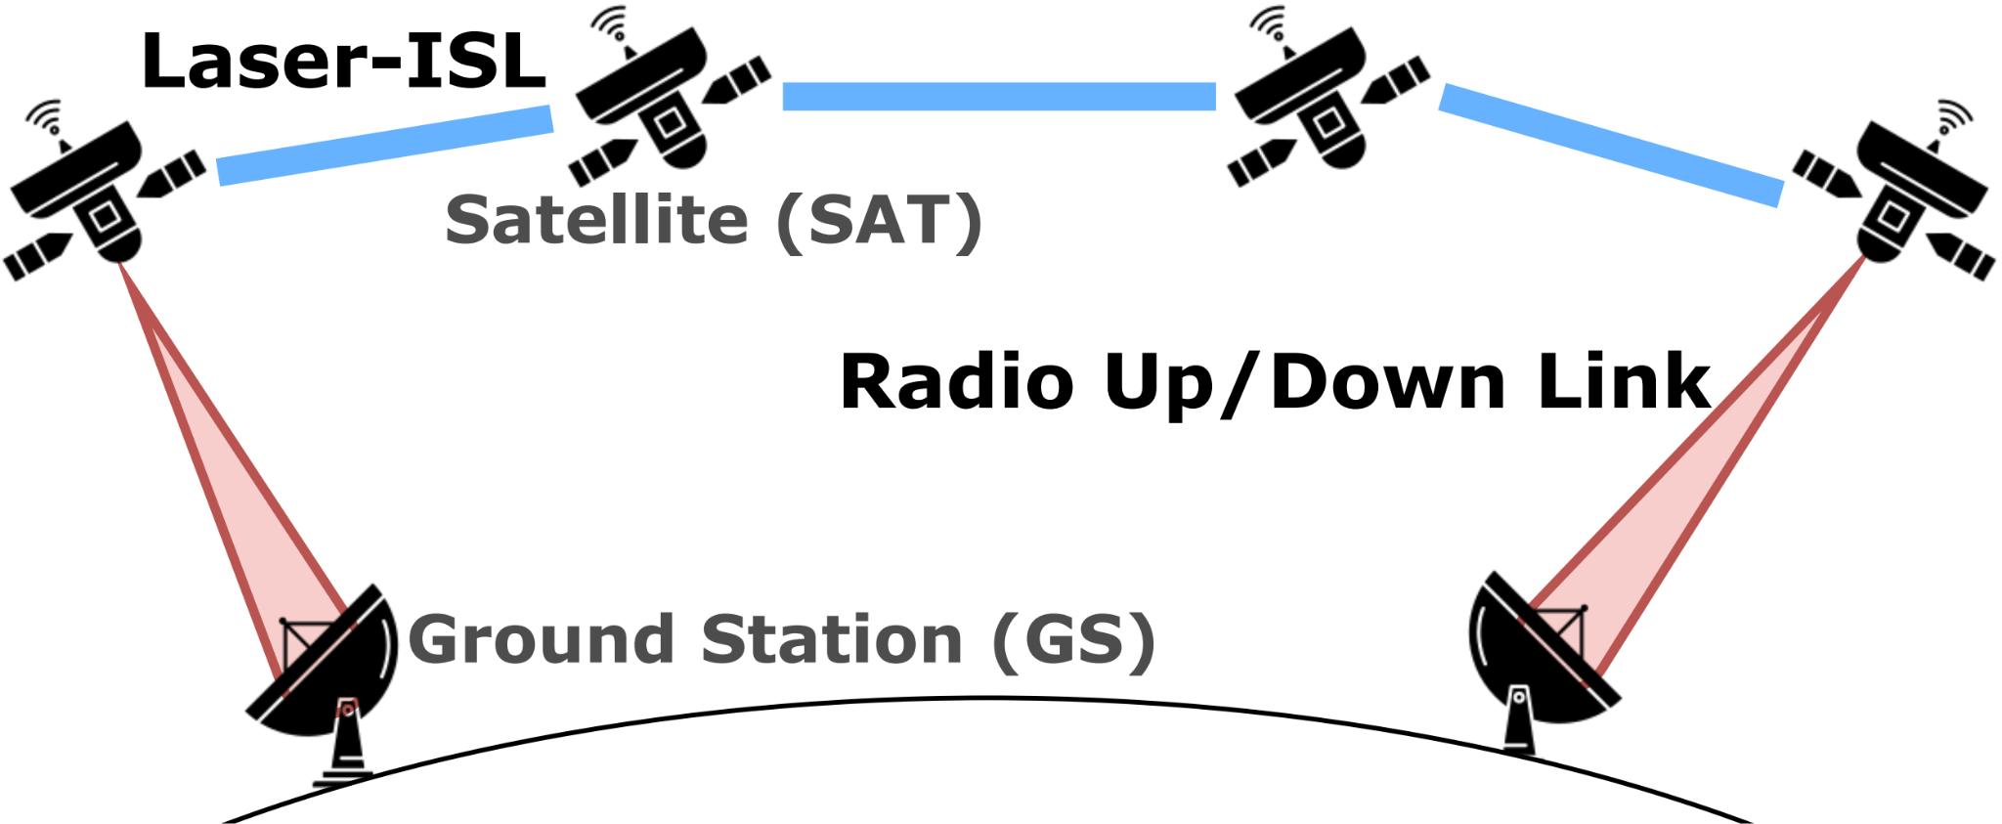
How do LEO constellations work?
Notes:
Now, we give a brief primer on how LEO constellations work.
On the LHS you see a typical configuration in the literature. Multiple GSes. Multiple Satellites. 2 types if links: radio SAT-to-GS links and SAT-to-SAT links (henceforth known as ISLs).
For the ISLs, various configurations have been described in the literature. Goal: ensure continuous connectivity. We note that proposed ISLs would be reconfigurable, with some downtime.
Mention “reconfigurable links”
Q:
Can GS accept connections to multiple SATs?
What is the orbital velocity of LEOs? Is it much faster? What is the period of LEOs? Is polar LEO longer or shorter orbital period?
orbital velocity is more than 27,000 km/hr, and satellites complete an orbit around the Earth in ∼100 minutes [6]. As satellites travel fast across GSes, GS-satellite links can only be maintained for a few minutes, after which they require a handoff. ISLs also continuously change in length
What is the distance of LEOs and MEOs from earth’s surface?

Slide 7
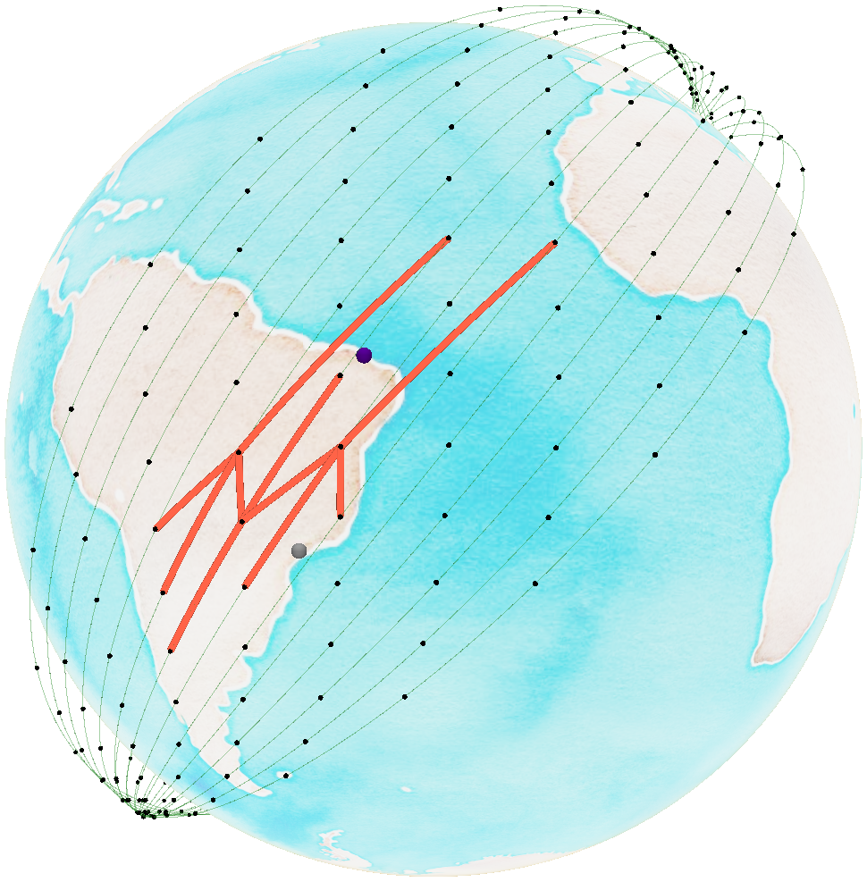
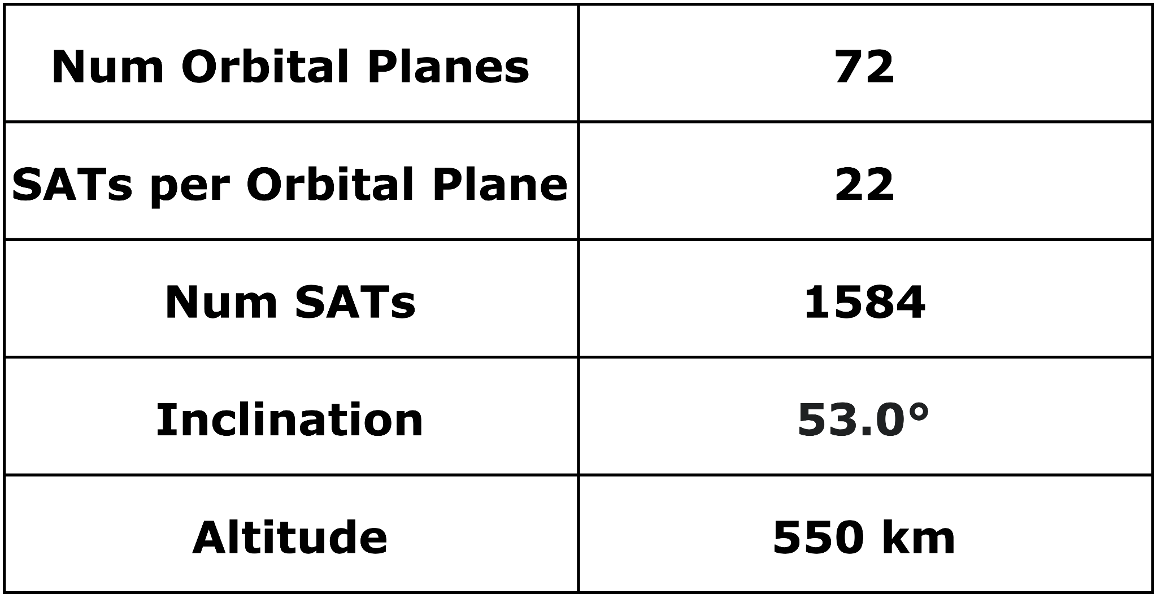
How do LEO constellations work?
Compared to GEOs:
Lower altitude (<2000 km vs >30000 km).
Shorter orbital period
Smaller cone of coverage
Orbital shells with many “parallel” planes
Notes:
Font size: 20, 18, 16
Here, in our globe picture, we see a brief depiction of what a LEO constellation would look like. More specifically, we see Starlink’s first shell. Subset of Starlink orbital planes
(green lines). A possible ISL configuration for some satellites
is shown (orange lines) in +grid: a Sat forms two links with
its immediate neighbours in the same plane and two links
to Sats in adjacent planes. Two GSs: São Paulo (gray), and
Fortaleza (purple).
And in the bottom right figure, we see some statistics of Starlink’s 1st shell.
TODOS: need to use our own cone picture on the LHS
TODOS: explain what is shorter orbital period. What is highly mobile and why. What is intermittent? What is distributed?
Q:
Why are some satellites more close to each other near certain regions?
What is GEO altitude? 35,786 KM
What are orbital shells and planes in relation to this globe? Don’t get the difference.
This is only 1 shell (starlink’s first shell), and only a subset of orbital planes from that shell.

Slide 8
How do LEO constellations work?
Highly Mobile, Distributed, Intermittent Infrastructure
Mobile
Not fixed to a geographic location
Orbiting the earth at ≈ 27,000km/h
Distributed
Large amount of infrastructure spread across the globe
Intermittent
Power and atmospheric attenuation
Notes:
Putting aside the fact that LEO constellations are very valuable CPS, here are 3 key properties, in summary, of LEO constellations
Intermittent: incapable to communicate with the SAT for some time

Slide 9
The pressing need for an emulator
Our contribution: Stargaze
Modelling unforeseen threats and defenses
Rapid Experimentation
Reproducibility
Emulation up the stack: real application code
Notes:
Stargaze is the emulator you need to model these properties. Just like emulators for traditional solutions.
In addition, with Stargaze, we want to enable users to:
Model unforeseen threats, including those shown earlier
Rapid iterations with different problems/solutions. Easily deployable on testbeds
Reproducibility: a given setup configuration needs to be replicated in a separate environment
Real application code: capture system-level effects (e.g., the extent to which an adversary-induced fault can have on application throughput) that could be crucial in real-time deployments. The ability to emulate application-level behavior is important as it increases the range of security experiments we can construct, such as application- level, asymmetric DoS attacks and defenses
We believe that the security community has much to offer in protecting the emerging LEO ecosystem. With thorough experimentation and analysis, researchers will be able to adapt tried-and-true defenses to space and rapidly test novel ideas for building solutions against newfound attacks.

Slide 10
Addressing the shortcomings of existing simulators
Lack network simulation capabilities
Examples: GMAT, STK, and [1]
Unable to model LEO constellations and their ISL topology
Examples: OpenSAND and SNS3
Not open-sourced
Examples: [1]
Only perform network-level simulation with traffic traces
Examples: Hypatia and cote
[1] Mark Handley. 2015. Delay is not an option: Low latency routing in space. In Proceedings of the 14th ACM Workshop on Hot Topics in Networks. 85–91.
Notes:
There are many existing simulators that aim to model various aspects of satellites, some even satellite constellations, but they are unsuitable.
Our community is currently handicapped by the lack of a proper security experimentation platform. Stargaze is a step to address the shortcomings of existing solutions.
More details can be found in the paper.

Slide 11
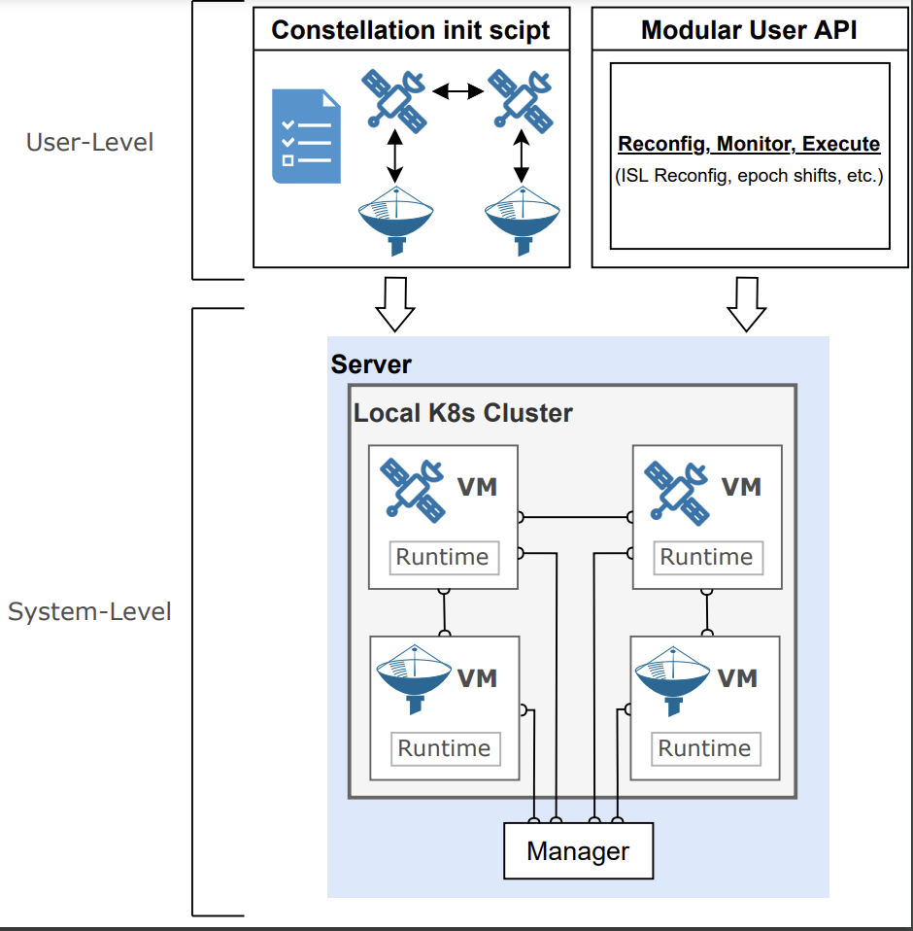
Stargaze Overview
Modularity
Mobility
Reconfigurability
Notes:
There are 3 important properties in stargaze’s design.
Modularity. This is a work in progress. We anticipate new features will be added, and they need to be done so easily.
Mobility: is a key property explained earlier, that stargaze emulates. For example, we can capture the geographic locations of satellites across time.
Runtime reconfigurability: there may be features of an actual constellation that can be configured at runtime. For example, the reconfiguration of ISL topologies. This needs to be provided by the emulator.

Slide 12
Stargaze Workflow (I)
Constellation initialization script
Devices
e.g., SAT & GS
Link connectivity
e.g., SAT-to-SAT
Constellation-wide parameters
e.g., location & timescale
Device specific parameters
e.g., altitude & inclination
Notes:
In the next few slides, we give an overview of how Stargaze works. You can refer to the paper for more details.
Here, we see that the user only has to provide a constellation init script. This basically describes the set of devices they’d like to model and their link connectivity
In particular, There are a set of constellation wide parameters that need to be provided.
This includes the choice of constellation (e.g., starlink 1st shell), ISL topologies, and so on.
Finally, a user can optionally provide device specific parameters for a more fine grained configuration:
Overall, We allow for a modular configuration of the emulation
You can refer to the paper for more details.

Slide 13
Stargaze Workflow (II)
System-Level design
Kubernetes-based cluster
Device -> VM
Custom CNI
Constellation manager
Bootstraps device states
Precomputes link related variations
Management interface
e.g., restarting Linux TC
Notes:
Next we talk about the system level design of Stargaze. We first note that This is by no means a definitive solution, and we expect Stargaze or other new LEO emulators, to readily adopt other combinations of software components that suit their particular needs. Note that we use COTS software components.
Sorry for the jargon
Kubernetes starts the vms with the previously specified resources. Each device thus corresponds to a VM.
Further, it generates, using our custom CNI, device to device connectivity.
Then, the manager takes over and Given the above configuration,
Bootstraps device states
e.g., location & altitude
Link latency, bandwidth, and connectivity variations:
according to the configured emulation timescale and timestep granularity (which essentially updates on a per time-slot basis).
Management interface: that basically allows for a variety of management tasks that are not related directly to an experiment configuration.
—-----
Ignore below:
Then, the manager takes over and Given the above configuration,
generates the state of each satellite using the two-line element format (a space industry standard)~\cite{kauderer2011nasa},
and
then, also precomputes, using tools from hypatia, all variations of link latency (propagation speed is \texttt{c}, the speed of light in a vacuum), bandwidth and connectivity before start-up, according to the configured emulation timescale and timestep granularity (which essentially updates on a per time-slot basis). This offline computation improves emulation fidelity by ensuring that computational overhead during the emulation itself is not affected by recomputations of orbital properties. To actually bring these changes into effect, we use Linux TC to adjust the connectivity in these virtual links.
Finally, we also provide a management interface, that basically allows for a variety of management tasks that are not related directly to an experiment configuration. This includes….
Note to self: this actually builds on top of the k8s interface to the VMs.

Slide 14
Stargaze Workflow (III)
Modular User API
Extensible
Support arbitrary use cases
Modules include
Runtime ISL topology changes
Per-node network telemetry
Notes:
Stargaze provides a modular user API that performs reconfigurations and moni-
toring. For instance, users can initiate runtime ISL topology recon-
figurations. This includes installing or tearing down links dynam-
ically, while ensuring that the properties of these new links (e.g.,
latency) are updated correctly in subsequent timesteps.
Extensible: The architecture of Stargaze adopts a modular organization,
so that new emulation features can be easily developed and added
to the platform over time here we can inject more modules for users to play with. Since this is abstracted as an API function call, users can make use of this API as they wish, or for use by satellite applications
Monitor here is slightly different from what the manager does. Here we are monitoring at a higher level, not internal. I.e., features that a security application observing the actual constellation would use.
—----------------
Ignore below:
automate the process of reconfiguring arbitrary groups of links
for experimentation purposes. (This feature is utilized in our case
study described in Section 4.) Similarly, they can extract metrics,
e.g., interface traffic, from the monitor through the modular user
API.
tasks. The architecture of Stargaze adopts a modular organization,
so that new emulation features can be easily developed and added
to the platform over time. For instance, Stargaze currently uses
separate runtime reconfiguration modules for ISL topology, latency
and bandwidth; Stargaze also implements a modular telemetry
module for traffic monitoring at each emulated node.

Slide 15
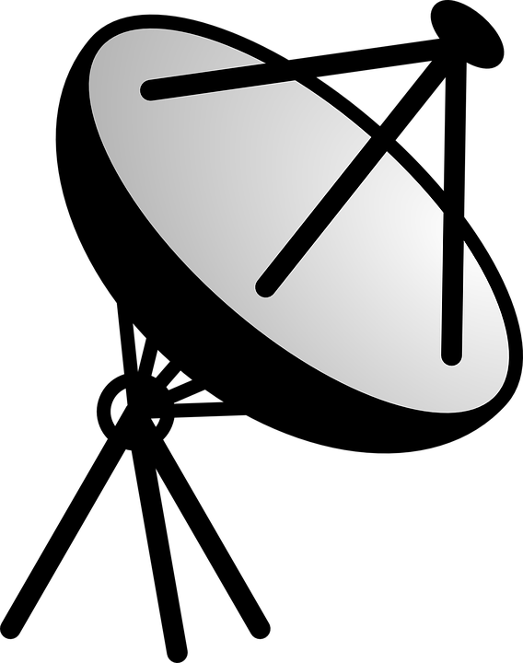
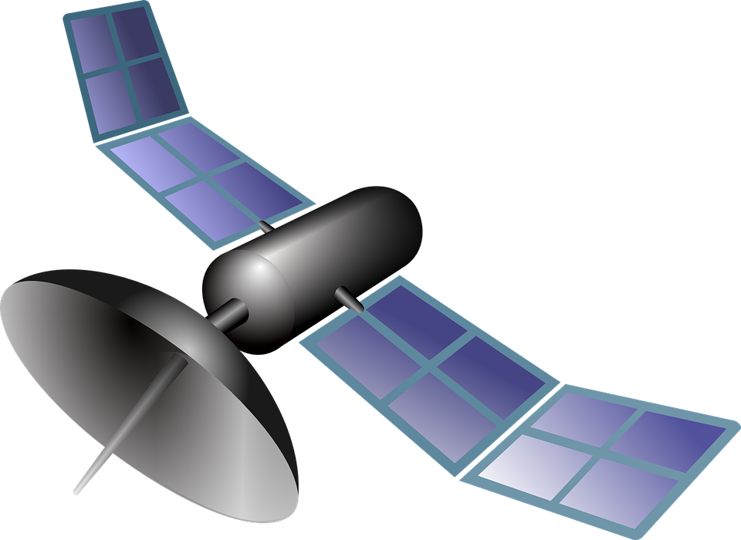
Evaluation through a case study:
Emulating defenses against constellation DDoS attacks
​​
Evaluation Setup:
Emulate two ground stations in Paris and Madrid
Cluster of six satellites above them, obtained from Starlink's first shell.
100 Mbps of benign traffic is transmitted between the two ground stations via the LEO constellation.
Notes:
A simple proof of concept scenario

Slide 16
Evaluation through a case study:
Emulating defenses against constellation DDoS attacks
ICARUS* attack:
Single shortest-path routing attack targeted at single ISL links
Attack Procedure:
Determine constellation's satellite positions
Create a connectivity graph (e.g., +grid)
Congest the target link
*Giuliari, Giacomo, et al. "{ICARUS}: Attacking low earth orbit satellite networks." 2021 USENIX Annual Technical Conference (USENIX ATC 21). 2021.
Notes:
Goal: Minimize amount of traffic required for an attack

Slide 17
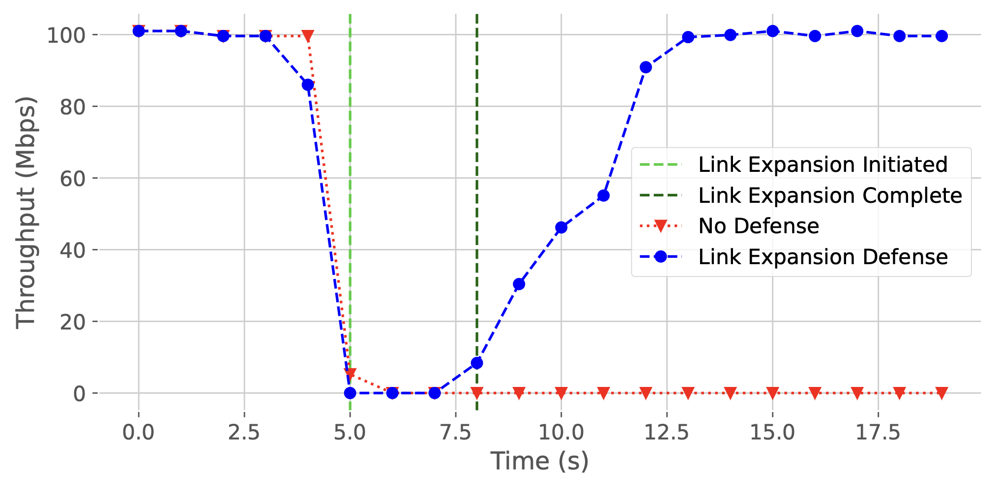
Defense 1: Link expansion
Observation: ICARUS leverages satellite positions that are publicly known
Defenses Exploit: ISL connectivity that is not known
Notes:
This defense dynamically reallocates an extra ISL
link to the attack target, therefore expanding the link and doubling
its bandwidth. The newly expanded link is no longer a bandwidth
bottleneck on this topology, so this drastically degrades the attack
Strength.
—-------
Ignore below:
The monitoring modules are similar as in the previous de-
fense, but the defense actions leverage the topology reconfiguration
capability of the emulator. It doubles the bandwidth that is required
for launching a successful attack, by taking away bandwidth from
other parts of the network. As seen in the plot, at t=5s, the defense
is activated and link expansion is initiated. This triggers an ISL
reconfiguration by establishing a new ISL link between the two
end-nodes (satellites) of the link, while disconnecting an existing
link that is not under attack.
We observe that this brings down the attack strength to a similar
degree as in Ripple, recovering normal traffic throughput.

Slide 18
Conclusions and ongoing work
Myriad services being created with growing interest from private industry
LEO constellations are prone to a number of understudied threats
Stargaze: LEO constellation emulator for modelling threat and defenses
Ongoing work: LEO constellations for security and additional modules
Thank you! Feel free to reach out for a chat!
Patrick Kon pk37@rice.edu
Notes:
LEO for security: We also plan to commence work on LEO constellations for se-
curity (Section 2.1). One direction would enable experimentation
on the performance and resilience of satellite surveillance systems.
We could for instance experiment with different LEO constellation
topologies that can accelerate the transmission of satellite imagery,
or fault tolerance mechanisms that rely on the dynamic reconfig-
uration of LEO constellations.
Modules: Examples include a) a crash fault module,
responsible for emulating satellite crash faults, ISLs failures and/or
disconnection [80]; b) a Byzantine fault module, responsible for
emulating rogue satellites, e.g., targeted by malware infections [63],
and; c) a satellite maneuvering module, responsible for emulating
satellite steering capabilities

